Slide 1
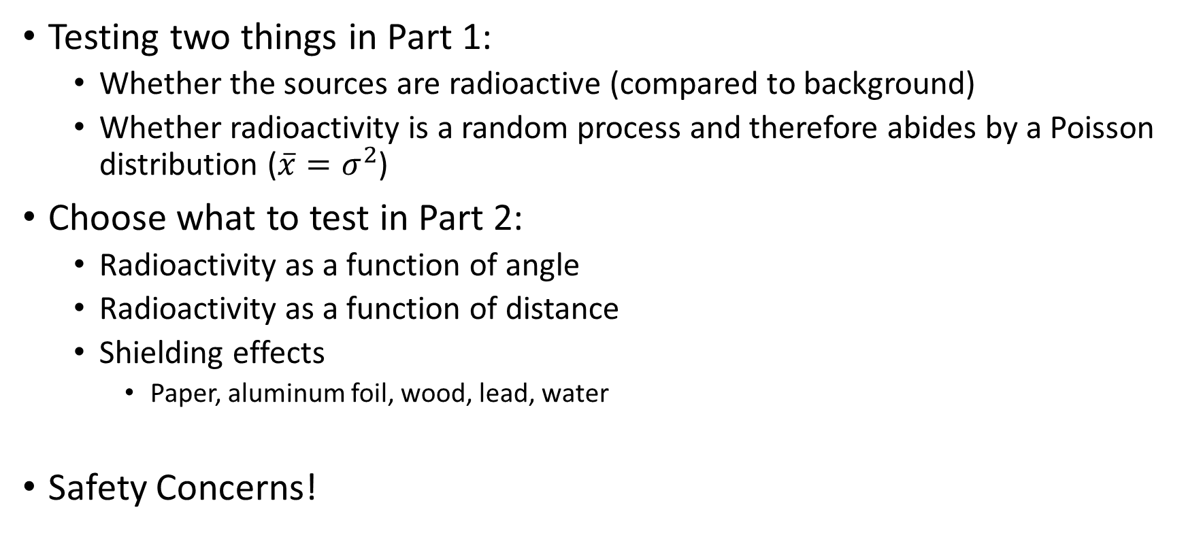
Lab 2
Testing two things in Part 1:
Whether the sources are radioactive (compared to background)
Whether radioactivity is a random process and therefore abides by a Poisson distribution ($\overline{x}=σ^{2}$)
Choose what to test in Part 2:
Radioactivity as a function of angle
Radioactivity as a function of distance
Shielding effects
Paper, aluminum foil, wood, lead, water
Safety Concerns!

Slide 2
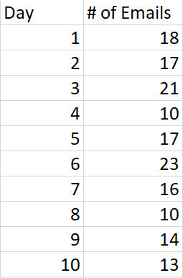
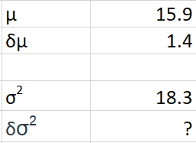
Prelab 2 Invention Activity – Poisson Distributions
$$μ=σ^{2}$$
$$μ is the mean value,σ is the std. dev.$$
$$t=\frac{|μ−σ^{2}|}{\sqrt{{\left(δμ\right)}^{2}+{\left(δσ^{2}\right)}^{2}}}$$

Slide 3
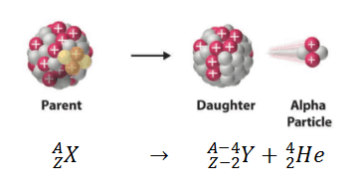
Nuclear Decay
Strong force drops off quickly as a function of distance
Large atoms (>Pb) become unstable because the SF doesn’t reach far enough to hold them stable¹
Alpha Particles (He nucleus) escape in a random process called “Quantum Tunneling”
Releases large amounts of energy!
¹While theoretically anything slightly larger than Nickel (#28) can experience alpha decay, we typically only consider large atoms as reliable alpha decay candidates due to experimental observations and considerations of half-lives

Slide 4
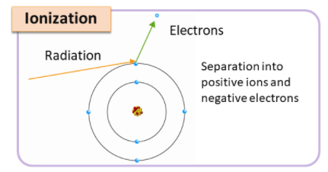
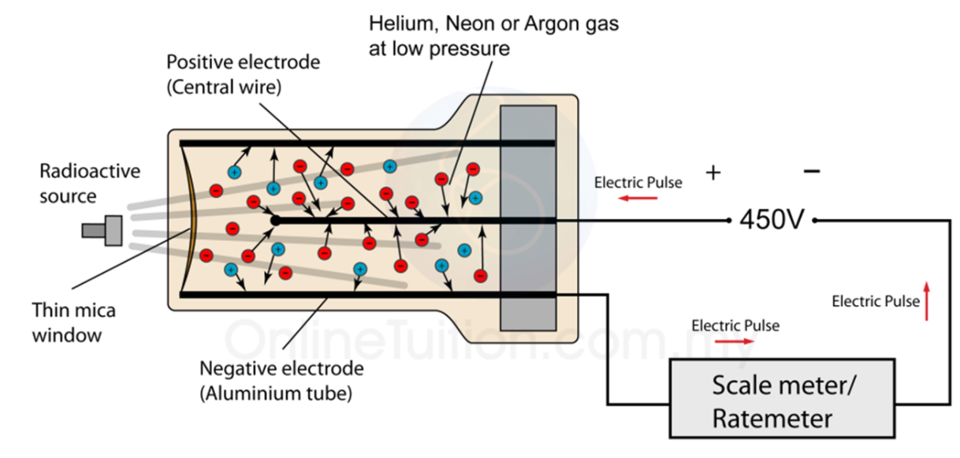
Ionizing Radiation and the Geiger-Muller Counter

